Slide 1
PROTEOMICS RESULTS
Data de entrega das amostras: 23/05/2019
Data de análise no MS/MS: 25/06/2019
Data de início de tratamento dos dados: 17/07/2019
Cátia Braga, João Sequeira, Andreia Salvador

Slide 2
Notes about the equipment and analysis conditions
Assay: Peptide mapping by nanoLC-MS using Sciex TripleTOF 6600 mass spectrometer.
Sample list:
Sample 1 – Pure culture of Methanobacterium formicicum during initial methane production phase (control)
Sample 2 – Pure culture of M. formicicum during exponential methane production phase (control)
Sample 3 – Pure culture of M. formicicum during the end of methane production phase (control)
Sample 4 – M. formicicum + 0.5 g/L activated carbon (AC) during initial methane production
Sample 5 – M. formicicum + 0.5 g/L AC during exponential methane production
Sample 6 – M. formicicum + 0.5 g/L AC during the end of methane production

Slide 3
Analysis with an uncertainty less than 10 %
Foram analisadas as proteínas diferencialmente expressas entre as duas condições testadas (com e sem carvão activado), isto é, análise baseada na presença vs ausência;
Foram analisadas as diferenças no nível de expressão das proteínas identificadas em ambas as condições (isto é, observou-se se houve um aumento ou diminuição de deteção da proteína comparando as duas condições)

Slide 4
Comparison between both conditions
Protein names | COG general functional category | COG functional category | COG protein description | Uncertainty (%) | Detection | Expression
Uncharacterized protein | CELLULAR PROCESSES AND SIGNALING | Cell wall/membrane/envelope biogenesis | Putative peptidoglycan-binding domain-containing protein | 0.00 | Detected in both | Underexpressed in AC
Anaerobic ribonucleoside-triphosphate reductase (EC 1.17.4.2) (Anaerobic ribonucleoside-triphosphate reductase NrdD) | METABOLISM | Nucleotide transport and metabolism | Oxygen-sensitive ribonucleoside-triphosphate reductase | 0.00 | Detected in AC | Detected in AC
30S ribosomal protein S4 | INFORMATION STORAGE AND PROCESSING | Translation, ribosomal structure and biogenesis | Ribosomal protein S4 and related proteins | 0.01 | Detected in control | Detected in control
Signal recognition particle 54 kDa protein (SRP54) | CELLULAR PROCESSES AND SIGNALING | Intracellular trafficking, secretion, and vesicular transport | Signal recognition particle GTPase | 0.02 | Detected in control | Detected in control
Transcription initiation factor IIB (TFIIB) | INFORMATION STORAGE AND PROCESSING | Transcription | Transcription initiation factor TFIIIB, Brf1 subunit/Transcription initiation factor TFIIB | 0.03 | Detected in control | Detected in control
CoB--CoM heterodisulfide reductase subunit A HdrA2 (CoB-CoM heterodisulfide reductase iron-sulfur subunit A) (EC 1.8.98.1) | METABOLISM | Energy production and conversion | Heterodisulfide reductase, subunit A and related polyferredoxins | 0.03 | Detected in both | Overexpressed in AC
50S ribosomal protein L15 | INFORMATION STORAGE AND PROCESSING | Translation, ribosomal structure and biogenesis | Ribosomal protein L15 | 0.53 | Detected in control | Detected in control
Putative pantothenate synthetase | POORLY CHARACTERIZED | Function unknown | Uncharacterized protein conserved in archaea | 1.04 | Detected in control | Detected in control
Ribonuclease J (RNase J) (EC 3.1.-.-) | POORLY CHARACTERIZED | General function prediction only | Predicted hydrolase of the metallo-beta-lactamase superfamily | 1.04 | Detected in control | Detected in control
Methyl-coenzyme M reductase subunit alpha (EC 2.8.4.1) | METABOLISM | Coenzyme transport and metabolism | Methyl coenzyme M reductase, alpha subunit | 6.49 | Detected in both | Overexpressed in AC
CTP synthase (EC 6.3.4.2) (Cytidine 5'-triphosphate synthase) (Cytidine triphosphate synthetase) (CTP synthetase) (CTPS) (UTP--ammonia ligase) | METABOLISM | Nucleotide transport and metabolism | CTP synthase (UTP-ammonia lyase) | 9.71 | Detected in AC | Detected in AC
NH(3)-dependent NAD(+) synthetase (EC 6.3.1.5) | METABOLISM | Coenzyme transport and metabolism | NAD synthase | 9.71 | Detected in control | Detected in control
2-aminoadipate transaminase (EC 2.6.1.39) | INFORMATION STORAGE AND PROCESSING | Transcription | Transcriptional regulators containing a DNA-binding HTH domain and an aminotransferase domain (MocR family) and their eukaryotic orthologs | 9.71 | Detected in control | Detected in control
V-type ATP synthase alpha chain (EC 7.1.2.2) (V-ATPase subunit A) | METABOLISM | Energy production and conversion | Archaeal/vacuolar-type H+-ATPase subunit A | 9.71 | Detected in both | Overexpressed in AC
30S ribosomal protein S19e | INFORMATION STORAGE AND PROCESSING | Translation, ribosomal structure and biogenesis | Ribosomal protein S19E (S16A) | 9.71 | Detected in control | Detected in control

Slide 5
Proteins detected only in the control assay
Protein names | Pathway | COG general functional category | COG functional category | COG protein description | Uncertainty (%)
30S ribosomal protein S4 |  | INFORMATION STORAGE AND PROCESSING | Translation, ribosomal structure and biogenesis | Ribosomal protein S4 and related proteins | 0.01
Signal recognition particle 54 kDa protein (SRP54) |  | CELLULAR PROCESSES AND SIGNALING | Intracellular trafficking, secretion, and vesicular transport | Signal recognition particle GTPase | 0.02
Transcription initiation factor IIB (TFIIB) |  | INFORMATION STORAGE AND PROCESSING | Transcription | Transcription initiation factor TFIIIB, Brf1 subunit/Transcription initiation factor TFIIB | 0.03
50S ribosomal protein L15 |  | INFORMATION STORAGE AND PROCESSING | Translation, ribosomal structure and biogenesis | Ribosomal protein L15 | 0.53
Putative pantothenate synthetase |  | POORLY CHARACTERIZED | Function unknown | Uncharacterized protein conserved in archaea | 1.04
Ribonuclease J (RNase J) (EC 3.1.-.-) |  | POORLY CHARACTERIZED | General function prediction only | Predicted hydrolase of the metallo-beta-lactamase superfamily | 1.04
NH(3)-dependent NAD(+) synthetase (EC 6.3.1.5) | PATHWAY: Cofactor biosynthesis; NAD(+) biosynthesis; NAD(+) from deamido-NAD(+) (ammonia route): step 1/1. {ECO:0000256|HAMAP-Rule:MF_00193, ECO:0000256|RuleBase:RU004252}. | METABOLISM | Coenzyme transport and metabolism | NAD synthase | 9.71
2-aminoadipate transaminase (EC 2.6.1.39) |  | INFORMATION STORAGE AND PROCESSING | Transcription | Transcriptional regulators containing a DNA-binding HTH domain and an aminotransferase domain (MocR family) and their eukaryotic orthologs | 9.71
30S ribosomal protein S19e |  | INFORMATION STORAGE AND PROCESSING | Translation, ribosomal structure and biogenesis | Ribosomal protein S19E (S16A) | 9.71
rRNA binding; Structural constituent of ribosome;
Biological process: translation
https://www.uniprot.org/uniprot/A0A089ZAY7
Function: Involved in targeting and insertion of nascent membrane proteins into the cytoplasmic membrane. Binds to the hydrophobic signal sequence of the ribosome-nascent chain (RNC) as it emerges from the ribosomes. The SRP-RNC complex is then targeted to the cytoplasmic membrane where it interacts with the SRP receptor FtsY. RNA binding https://www.uniprot.org/uniprot/A0A090I333
Function: Stabilizes TBP binding to an archaeal box-A promoter. Also responsible for recruiting RNA polymerase II to the pre-initiation complex (DNA-TBP-TFIIB). https://www.uniprot.org/uniprot/A0A090JSM8
rRNA binding; Structural constituent of ribosome;
Biological process: translation https://www.uniprot.org/uniprot/A0A090I4H6

Slide 6
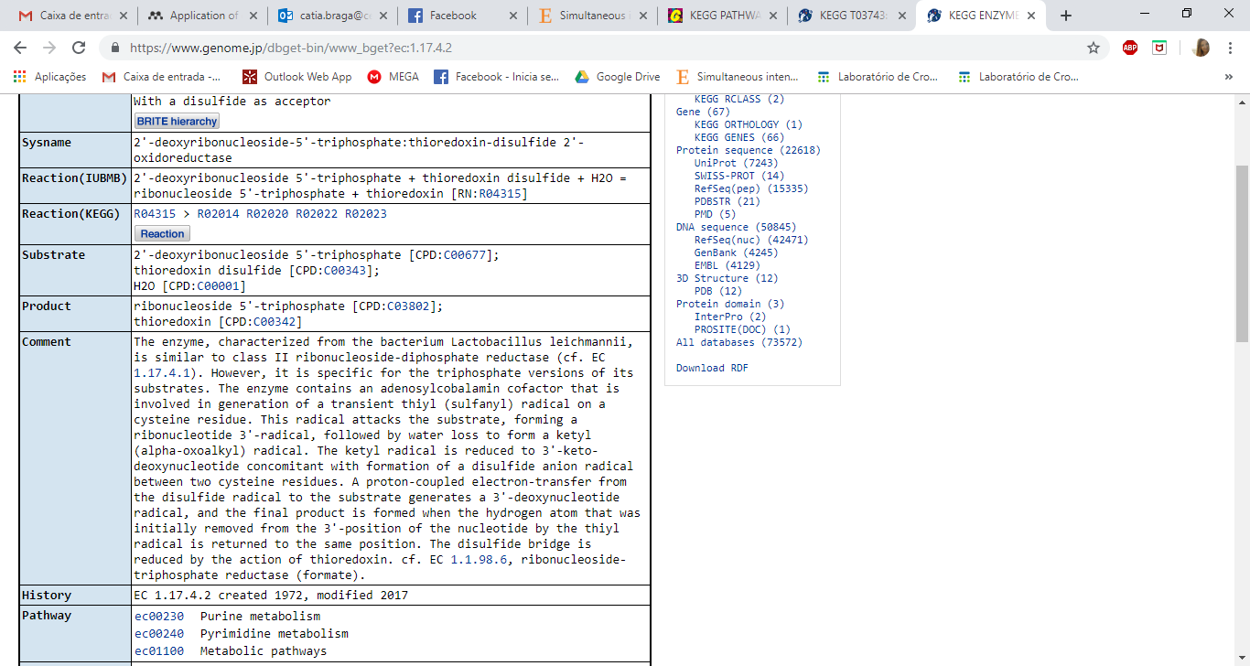
Proteins detected only in the assay with 0.5 g/L AC
Protein names | Pathway | COG general functional category | COG functional category | COG protein description | Uncertainty (%)
Anaerobic ribonucleoside-triphosphate reductase (EC 1.17.4.2) (Anaerobic ribonucleoside-triphosphate reductase NrdD) |  | METABOLISM | Nucleotide transport and metabolism | Oxygen-sensitive ribonucleoside-triphosphate reductase | 0.00
CTP synthase (EC 6.3.4.2) (Cytidine 5'-triphosphate synthase) (Cytidine triphosphate synthetase) (CTP synthetase) (CTPS) (UTP--ammonia ligase) | PATHWAY: Pyrimidine metabolism; CTP biosynthesis via de novo pathway; CTP from UDP: step 2/2. {ECO:0000256|HAMAP-Rule:MF_01227}. | METABOLISM | Nucleotide transport and metabolism | CTP synthase (UTP-ammonia lyase) | 9.71
Anaerobic growth
CTP + formate
ATP binding;
DNA replication
https://www.uniprot.org/uniprot/A0A090JW98
=formate
Function: Catalyzes the ATP-dependent amination of UTP to CTP with either L-glutamine or ammonia as the source of nitrogen. Regulates intracellular CTP levels through interactions with the four ribonucleotide triphosphates https://www.uniprot.org/uniprot/A0A090JXV9
ATP binding; CTP synthase
citosina
https://www.genome.jp/dbget-bin/www_bget?ec:1.17.4.2
https://www.genome.jp/dbget-bin/www_bget?mfi:DSM1535_1468

Slide 7
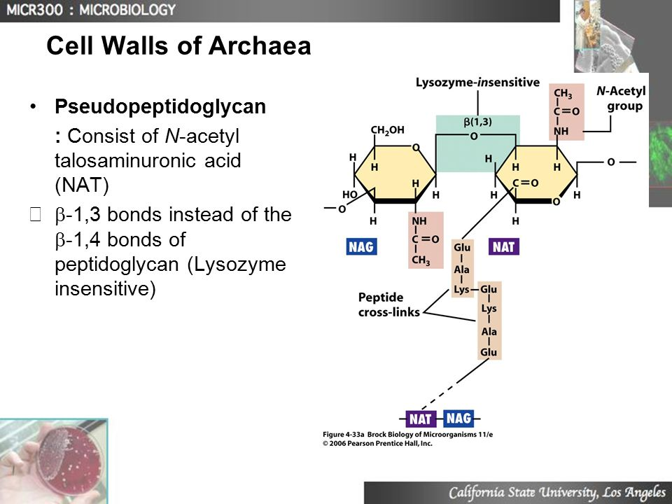
Proteins detected in both conditions with different levels of detection
Protein names | Pathway | COG general functional category | COG functional category | COG protein description | Uncertainty (%) | Expression
Uncharacterized protein |  | CELLULAR PROCESSES AND SIGNALING | Cell wall/membrane/envelope biogenesis | Putative peptidoglycan-binding domain-containing protein | 0.00 | Underexpressed in AC
CoB--CoM heterodisulfide reductase subunit A HdrA2 (CoB-CoM heterodisulfide reductase iron-sulfur subunit A) (EC 1.8.98.1) |  | METABOLISM | Energy production and conversion | Heterodisulfide reductase, subunit A and related polyferredoxins | 0.03 | Overexpressed in AC
Methyl-coenzyme M reductase subunit alpha (EC 2.8.4.1) | PATHWAY: One-carbon metabolism; methyl-coenzyme M reduction; methane from methyl-coenzyme M: step 1/1. {ECO:0000256|PIRNR:PIRNR000262}. | METABOLISM | Coenzyme transport and metabolism | Methyl coenzyme M reductase, alpha subunit | 6.49 | Overexpressed in AC
V-type ATP synthase alpha chain (EC 7.1.2.2) (V-ATPase subunit A) |  | METABOLISM | Energy production and conversion | Archaeal/vacuolar-type H+-ATPase subunit A | 9.71 | Overexpressed in AC
https://www.ncbi.nlm.nih.gov/protein/WP_048073207.1/
Peptidoglycan binding domains have a general peptidoglycan binding function and a common core structure consisting of a closed, three-helical bundle with a left-handed twist. It is found at the N or C terminus of a variety of enzymes involved in bacterial cell wall degradation
peptidoglycan-binding protein [Methanobacterium formicicum]
Molecular function: Catalysis of the reaction: coenzyme B + coenzyme M + methanophenazine = N-{7-[(2-sulfoethyl)dithio]heptanoyl}-3-O-phospho-L-threonine + dihydromethanophenazine. https://www.ebi.ac.uk/QuickGO/term/GO:0051912
Foi sempre mais detetada em todas as fases de crescimento comparado com o control
Function: Component of the methyl-coenzyme M reductase (MCR) I that catalyzes the reductive cleavage of methyl-coenzyme M (CoM-S-CH3 or 2-(methylthio)ethanesulfonate) using coenzyme B (CoB or 7-mercaptoheptanoylthreonine phosphate) as reductant which results in the production of methane and the mixed heterodisulfide of CoB and CoM (CoM-S-S-CoB). This is the final step in methanogenesis https://www.uniprot.org/uniprot/A0A090I2G6
Produces ATP from ADP in the presence of a proton gradient across the membrane. The archaeal alpha chain is a catalytic subunit. https://www.uniprot.org/uniprot/A0A090I2M3

Slide 8
Analysis with an uncertainty between 10 % and 20 %

Slide 9
Comparison between both conditions
Protein names | COG general functional category | COG functional category | COG protein description | Uncertainty (%) | Detection | Expression
ATP phosphoribosyltransferase (ATP-PRT) (ATP-PRTase) (EC 2.4.2.17) | METABOLISM | Amino acid transport and metabolism | ATP phosphoribosyltransferase | 10.34 | Detected in control | Detected in control
ATP-dependent protease S16 family (Archaeal Lon protease) (EC 3.4.21.-) | CELLULAR PROCESSES AND SIGNALING | Posttranslational modification, protein turnover, chaperones | Predicted ATP-dependent protease | 10.89 | Detected in control | Detected in control
F420-non-reducing hydrogenase subunit A (EC 1.12.99.-) | METABOLISM | Energy production and conversion | Coenzyme F420-reducing hydrogenase, alpha subunit | 11.59 | Detected in both | Overexpressed in AC
Arginine--tRNA ligase (EC 6.1.1.19) (Arginyl-tRNA synthetase) (ArgRS) | INFORMATION STORAGE AND PROCESSING | Translation, ribosomal structure and biogenesis | Arginyl-tRNA synthetase | 13.59 | Detected in AC | Detected in AC
Proteasome subunit beta (EC 3.4.25.1) (20S proteasome beta subunit) (Proteasome core protein PsmB) | CELLULAR PROCESSES AND SIGNALING | Posttranslational modification, protein turnover, chaperones | 20S proteasome, alpha and beta subunits | 15.03 | Detected in both | Underexpressed in AC
Methyl-coenzyme M reductase subunit alpha (EC 2.8.4.1) | METABOLISM | Coenzyme transport and metabolism | Methyl coenzyme M reductase, alpha subunit | 16.94 | Detected in both | Overexpressed in AC
Malate dehydrogenase (EC 1.1.1.37) | METABOLISM | Energy production and conversion | Malate/lactate dehydrogenases | 18.68 | Detected in control | Detected in control
Uncharacterized protein | CELLULAR PROCESSES AND SIGNALING | Posttranslational modification, protein turnover, chaperones | La protein, small RNA-binding pol III transcript stabilizing protein and related La-motif-containing proteins involved in translation | 18.96 | Detected in AC | Detected in AC
Exosome subunit (Ribosome maturation protein SDO1 homolog) | INFORMATION STORAGE AND PROCESSING | Translation, ribosomal structure and biogenesis | Predicted exosome subunit | 18.96 | Detected in control | Detected in control
5'-deoxyadenosine deaminase (5'-dA deaminase) (EC 3.5.4.41) (5'-methylthioadenosine deaminase) (MTA deaminase) (EC 3.5.4.31) (Adenosine deaminase) (EC 3.5.4.4) (S-adenosylhomocysteine deaminase) (SAH deaminase) (EC 3.5.4.28) | METABOLISM | Nucleotide transport and metabolism | Cytosine deaminase and related metal-dependent hydrolases | 18.96 | Detected in AC | Detected in AC
Uncharacterized protein | POORLY CHARACTERIZED | Function unknown | Uncharacterized conserved protein | 18.96 | Detected in AC | Detected in AC
Carbamoyl-phosphate synthase small chain (EC 6.3.5.5) (Carbamoyl-phosphate synthetase glutamine chain) | METABOLISM | Amino acid transport and metabolism | Carbamoylphosphate synthase small subunit | 18.96 | Detected in control | Detected in control
DNA ligase (EC 6.5.1.1) (Polydeoxyribonucleotide synthase [ATP]) | INFORMATION STORAGE AND PROCESSING | Replication, recombination and repair | ATP-dependent DNA ligase | 18.96 | Detected in control | Detected in control
CBS domain-containing protein | POORLY CHARACTERIZED | General function prediction only | FOG: CBS domain | 18.96 | Detected in control | Detected in control
Replication factor-A domain-containing protein | INFORMATION STORAGE AND PROCESSING | Replication, recombination and repair | Single-stranded DNA-binding replication protein A (RPA), large (70 kD) subunit and related ssDNA-binding proteins | 18.96 | Detected in both | Overexpressed in AC
30S ribosomal protein S4e | INFORMATION STORAGE AND PROCESSING | Translation, ribosomal structure and biogenesis | Ribosomal protein S4E | 18.96 | Detected in both | Underexpressed in AC
Uncharacterized protein | POORLY CHARACTERIZED | General function prediction only | Uncharacterized protein (ATP-grasp superfamily) | 18.96 | Detected in control | Detected in control
Elongation factor 2 (EF-2) | INFORMATION STORAGE AND PROCESSING | Translation, ribosomal structure and biogenesis | Translation elongation factors (GTPases) | 18.96 | Detected in both | Overexpressed in AC
Histidine kinase/response regulator hybrid protein (Signal transduction histidine kinase) | CELLULAR PROCESSES AND SIGNALING | Signal transduction mechanisms | Signal transduction histidine kinase | 19.03 | Detected in control | Detected in control

Slide 10
Proteins detected only in the control assay
Protein names | Pathway | COG general functional category | COG functional category | COG protein description | Uncertainty (%)
ATP phosphoribosyltransferase (ATP-PRT) (ATP-PRTase) (EC 2.4.2.17) | PATHWAY: Amino-acid biosynthesis; L-histidine biosynthesis; L-histidine from 5-phospho-alpha-D-ribose 1-diphosphate: step 1/9. {ECO:0000256|HAMAP-Rule:MF_00079}. | METABOLISM | Amino acid transport and metabolism | ATP phosphoribosyltransferase | 10.34
ATP-dependent protease S16 family (Archaeal Lon protease) (EC 3.4.21.-) |  | CELLULAR PROCESSES AND SIGNALING | Posttranslational modification, protein turnover, chaperones | Predicted ATP-dependent protease | 10.89
Malate dehydrogenase (EC 1.1.1.37) |  | METABOLISM | Energy production and conversion | Malate/lactate dehydrogenases | 18.68
Exosome subunit (Ribosome maturation protein SDO1 homolog) |  | INFORMATION STORAGE AND PROCESSING | Translation, ribosomal structure and biogenesis | Predicted exosome subunit | 18.96
Carbamoyl-phosphate synthase small chain (EC 6.3.5.5) (Carbamoyl-phosphate synthetase glutamine chain) | PATHWAY: Amino-acid biosynthesis; L-arginine biosynthesis; carbamoyl phosphate from bicarbonate: step 1/1. {ECO:0000256|HAMAP-Rule:MF_01209}.; PATHWAY: Pyrimidine metabolism; UMP biosynthesis via de novo pathway; (S)-dihydroorotate from bicarbonate: step 1/3. {ECO:0000256|HAMAP-Rule:MF_01209}. | METABOLISM | Amino acid transport and metabolism | Carbamoylphosphate synthase small subunit | 18.96
DNA ligase (EC 6.5.1.1) (Polydeoxyribonucleotide synthase [ATP]) |  | INFORMATION STORAGE AND PROCESSING | Replication, recombination and repair | ATP-dependent DNA ligase | 18.96
CBS domain-containing protein |  | POORLY CHARACTERIZED | General function prediction only | FOG: CBS domain | 18.96
Uncharacterized protein |  | POORLY CHARACTERIZED | General function prediction only | Uncharacterized protein (ATP-grasp superfamily) | 18.96
Histidine kinase/response regulator hybrid protein (Signal transduction histidine kinase) |  | CELLULAR PROCESSES AND SIGNALING | Signal transduction mechanisms | Signal transduction histidine kinase | 19.03

Slide 11
Proteins detected only in the assay with 0.5 g/L AC
Protein names | Pathway | COG general functional category | COG functional category | COG protein description | Uncertainty (%)
Arginine--tRNA ligase (EC 6.1.1.19) (Arginyl-tRNA synthetase) (ArgRS) |  | INFORMATION STORAGE AND PROCESSING | Translation, ribosomal structure and biogenesis | Arginyl-tRNA synthetase | 13.59
Uncharacterized protein |  | CELLULAR PROCESSES AND SIGNALING | Posttranslational modification, protein turnover, chaperones | La protein, small RNA-binding pol III transcript stabilizing protein and related La-motif-containing proteins involved in translation | 18.96
5'-deoxyadenosine deaminase (5'-dA deaminase) (EC 3.5.4.41) (5'-methylthioadenosine deaminase) (MTA deaminase) (EC 3.5.4.31) (Adenosine deaminase) (EC 3.5.4.4) (S-adenosylhomocysteine deaminase) (SAH deaminase) (EC 3.5.4.28) | PATHWAY: Amino-acid biosynthesis; S-adenosyl-L-methionine biosynthesis. {ECO:0000256|HAMAP-Rule:MF_01281}. | METABOLISM | Nucleotide transport and metabolism | Cytosine deaminase and related metal-dependent hydrolases | 18.96
Uncharacterized protein |  | POORLY CHARACTERIZED | Function unknown | Uncharacterized conserved protein | 18.96

Slide 12
Proteins detected in both conditions with different levels of detection
Protein names | Pathway | COG general functional category | COG functional category | COG protein description | Uncertainty (%) | Expression
F420-non-reducing hydrogenase subunit A (EC 1.12.99.-) |  | METABOLISM | Energy production and conversion | Coenzyme F420-reducing hydrogenase, alpha subunit | 11.59 | Overexpressed in AC
Proteasome subunit beta (EC 3.4.25.1) (20S proteasome beta subunit) (Proteasome core protein PsmB) |  | CELLULAR PROCESSES AND SIGNALING | Posttranslational modification, protein turnover, chaperones | 20S proteasome, alpha and beta subunits | 15.03 | Underexpressed in AC
Methyl-coenzyme M reductase subunit alpha (EC 2.8.4.1) | PATHWAY: One-carbon metabolism; methyl-coenzyme M reduction; methane from methyl-coenzyme M: step 1/1. {ECO:0000256|PIRNR:PIRNR000262}. | METABOLISM | Coenzyme transport and metabolism | Methyl coenzyme M reductase, alpha subunit | 16.94 | Overexpressed in AC
Replication factor-A domain-containing protein |  | INFORMATION STORAGE AND PROCESSING | Replication, recombination and repair | Single-stranded DNA-binding replication protein A (RPA), large (70 kD) subunit and related ssDNA-binding proteins | 18.96 | Overexpressed in AC
30S ribosomal protein S4e |  | INFORMATION STORAGE AND PROCESSING | Translation, ribosomal structure and biogenesis | Ribosomal protein S4E | 18.96 | Underexpressed in AC
Elongation factor 2 (EF-2) |  | INFORMATION STORAGE AND PROCESSING | Translation, ribosomal structure and biogenesis | Translation elongation factors (GTPases) | 18.96 | Overexpressed in AC
Não é assim muito diferente, principalmente no ínicio; maiores diferenças na exponencial e final

Slide 13
Methanogenesis pathway
In the assay with AC it was over detected the following proteins/coenzymes: F420, CoM-S-CH3, CoM-SH, which are associated to methane production.
Hypothesis: in the control, the number of cells can be higher because the initial energy available is used for cell growth (ver proteínas), while with the presence of AC, the cells start from the beginning to produce methane. Only when the control reaches a high number of cells it can equal the methane production of the assay with AC.
Important to verify: to measure N total during the stages of growth and compare both conditions. Are the differences on the number/amount of cells truly significative?
What is the role of AC?

Slide 14
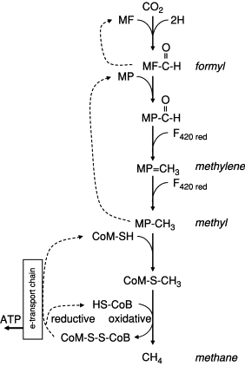
https://www.sciencedirect.com/topics/agricultural-and-biological-sciences/methanofuran
Figure 10.5. Outline of the biochemistry of methane formation from CO₂⧸H₂. CO₂ is activated with a methanofuran-containing enzyme (MF) with the reduction of the carbon to the level of formyl. The formyl carbon is transferred to an enzyme containing methanopterin (MP) with reduction steps to the methylene and methyl levels. The methyl carbon is transferred to a coenzyme M (CoM)-containing enzyme, forming CoM-S-CH₃. Methane is formed as this complex combines with HS-CoB, forming also the heterodisulfide CoM-S-S-CoB. ATP is conserved as this complex is reduced back to the sulfide-bonded coenzymes. Modified from Madigan et al. (2003), with inspiration from Thauer (1998).

Slide 15
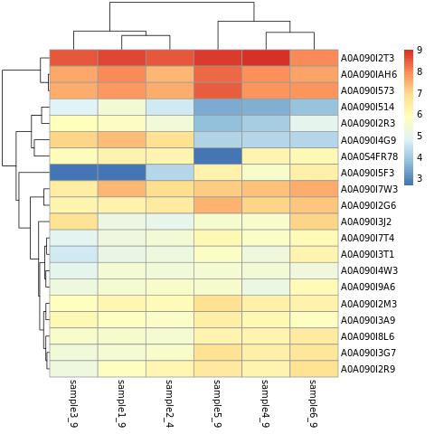
Gene expression
Control without material
M. formicicum + 0.5 g/L AC

Slide 16
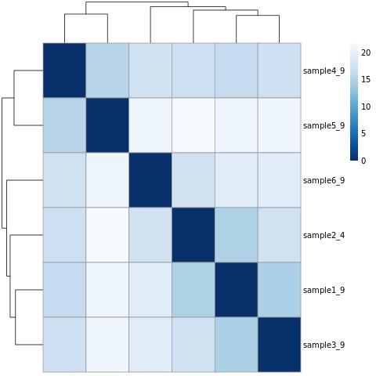
Sample distances
M. formicicum + 0.5 g/L AC
Control without material

Slide 17
Results analysis from the MS people
 | MS people | Compomics
Quantification technique | Peptide count | Spectra count
Proteins detected | 928 | 684
Organisms included in DB (organism ID) | Methanobacterium formicicum DSM1535 (2162) Methanobacterium formicicum DSM3637 (1204725) | Methanobacterium formicicum DSM1535 (2162)

Slide 18

Original analysis (ITQB) vs compomics analysis (ours) number of protein identifications
M. formicicum proteome: 2393 proteins
1592
Proteins of m. formicicum’s proteome were not identified by any method
117
Were identified only by them
119 Were identified only by us
565
Were identified by both
246
Were identified by them from the other strain
0
0
Original analysis: 928 proteins
Compomics analysis: 684 proteins

